Slide 1
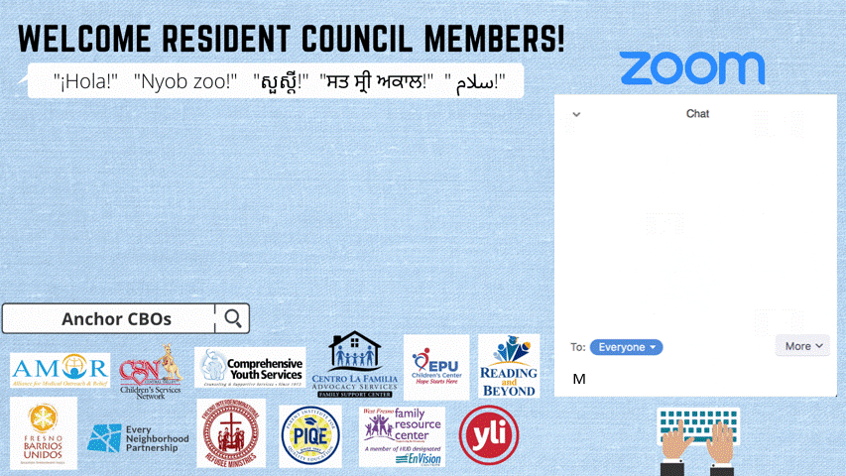
Notes:
Mike will welcome everyone and remind them to put their name and organization in the chat box.

Slide 2
Let’s look at the results for the top vision and mission statements…
Notes:
Wendy will share the results for the top vision and mission statement.
3 minutes

Slide 3

Understanding the
Fresno Landscape
Resident Council Training
Training Module 3
Presenter: Artie Padilla
Notes:
Mike introduce the topic and make connections to the way this understanding will help us be equipped to identify a problem and with a structured approach move toward a change in policy.
3 min

Slide 4
AGENDA
Vision and Mission Voting Results
Group Norms
Meet the Presenter
Systems Thinking
Resident Engagement
Extended Learning and Next Steps
Community Resources
Notes:
Mike 2 min

Slide 5
Let’s review our norms...
1. Be open to new ideas
2. Listen to each speaker
3. Make equal time for all to share
4. In person meeting: Please keep your phone on silent, and if you
need to answer the phone, please excuse yourself from the room.
5. During a virtual meeting we encourage you to have the camera on
to be fully engaged
6. Treat others the way you would like to be treated
Notes:
Wendy 2 min

Slide 6

OUTCOME FOR THIS TRAININGour training
Today we will learn how to develop understanding of systems thinking to move from identifying an issue to changing a policy.
Notes:
Mike 2 min

Slide 7
Vocabularyary
System- a set of things working together as parts of an interconnecting network
Structure- the arrangement of and relations between the parts of elements of
something complex
Organization- an organized body of people with a particular purpose
Ecosystem- a complex network or interconnected system
Values- one’s judgement of what is important in life
Notes:
Wendy reviews vocabulary 3 min

Slide 8
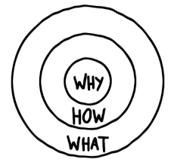
Why, How, What?
“Why” will always drive this work with the vision in mind created with our values.
“How” will include our mission statement and goals to achieve in this process.
“What” is the product we will create in the end together.
These are the Big Ideas!
Notes:
Mike explains the Golden Circle 5 min

Slide 9
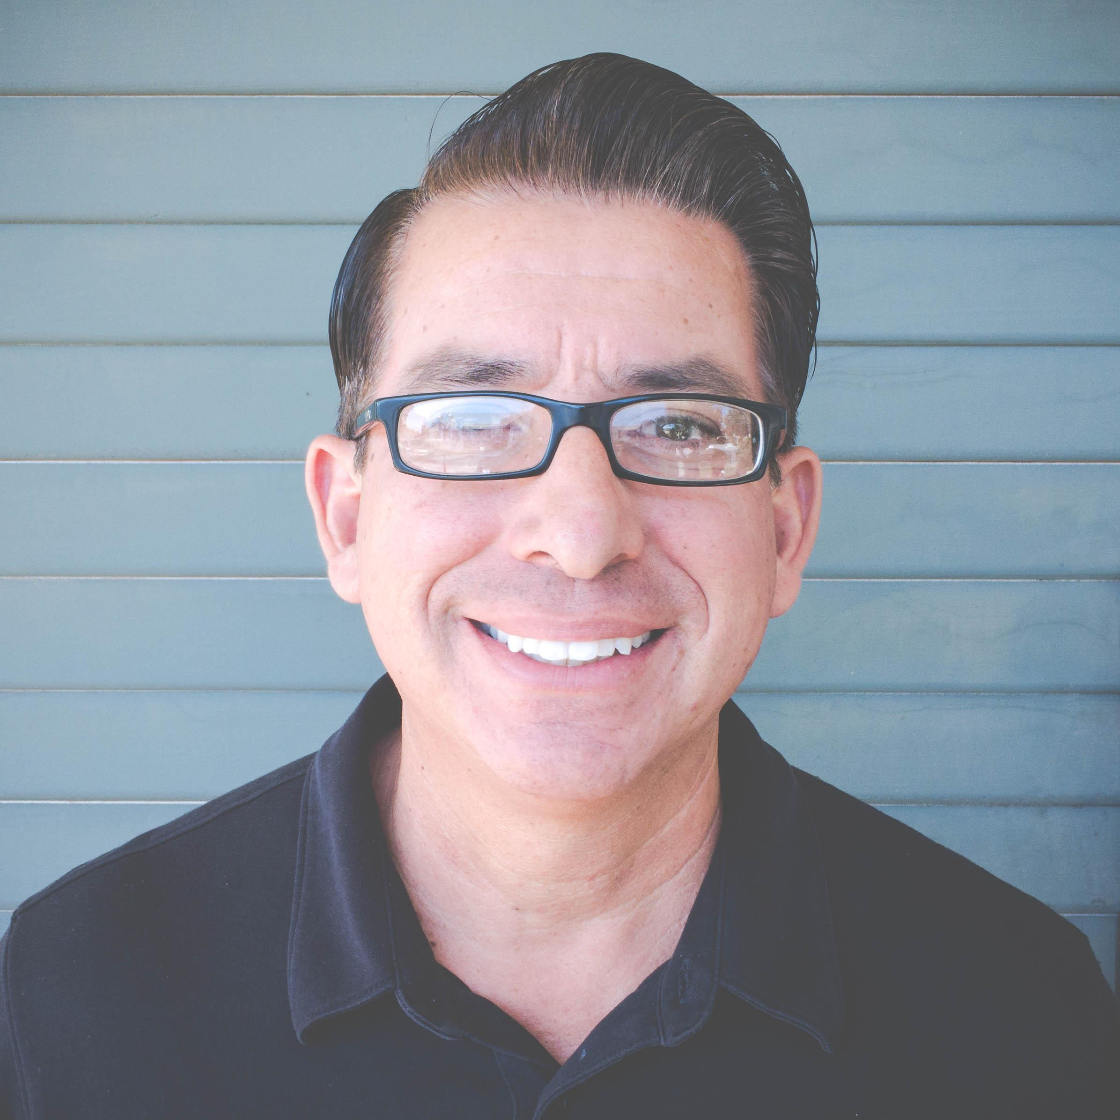
Artie Padilla
Born and raised in Fresno
28 years working in the non-profit sector
Worked closely with Fresno’s public elementary schools and neighborhoods to create Every Neighborhood Partnership
2017 created Fresno County Trauma and Resilience Network
Currently, Senior Program Officer for Central Valley Community Foundation
Notes:
Mike will introduce Artie, and Artie will share about his background
5 min

Slide 10

Systems Thinking
Data & CBO Connections
Topic: Transportation
Notes:
Artie will describe the how systems thinking is important to determine steps to solve a problem.
2 min

Slide 11

SYSTEMS ICEBERG
Notes:
Artie explains the systems iceberg structure
3 min

Slide 12
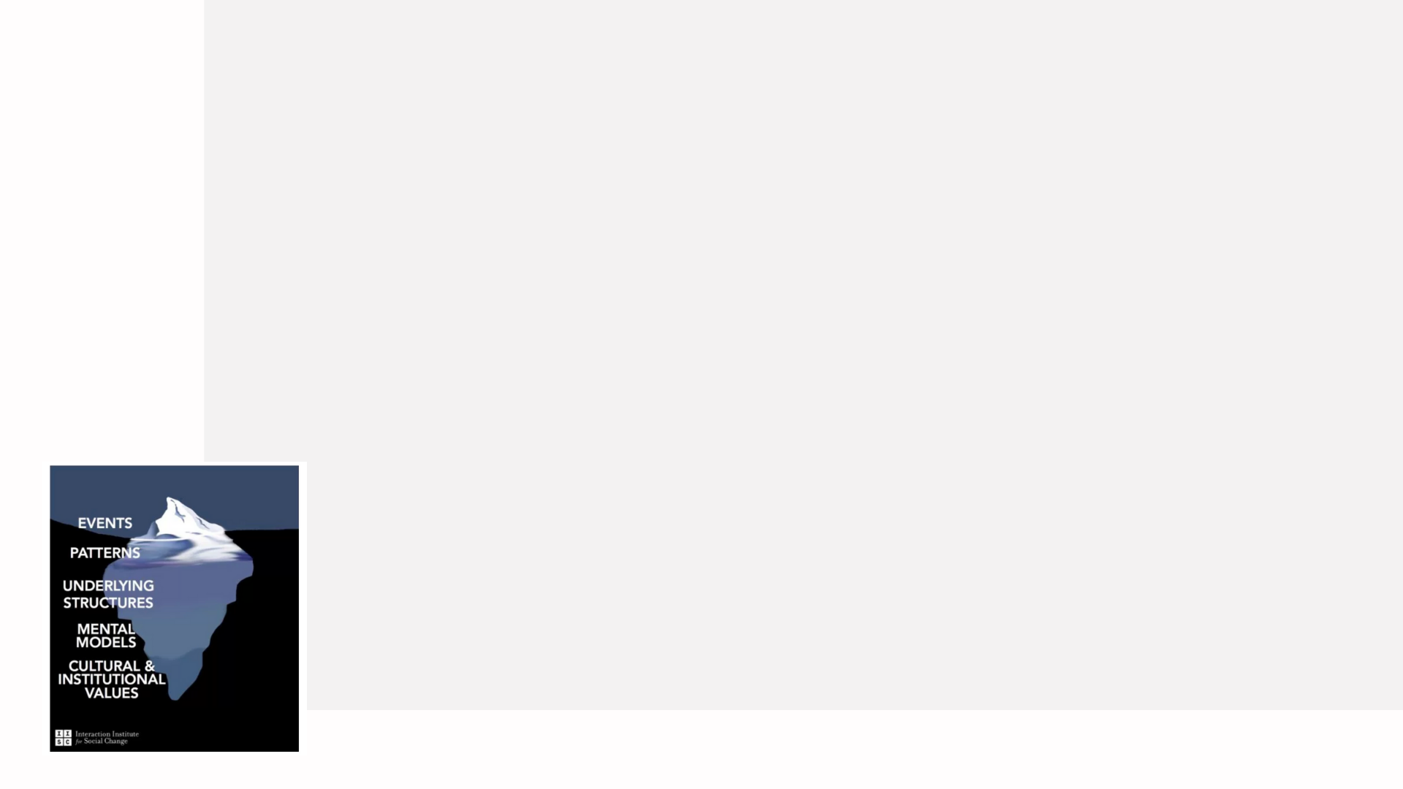
EVENTS
Current Situation
Hard to get to work using public transportation
Rural towns have added challenges
Poor road maintenance
Distance to school too far for students to walk and not safe
No dedicated bike lanes
Notes:
Artie- Current Situation (identified problem)
5 min

Slide 13

PATTERNS
Too much time needed to get cross town or cross county
Use taxis or uber/lyft instead of buses (economic effect)
Wear and tear on your vehicle
Parents with cars prefer to drop off kids at school (congestion/activity)
Parents don’t let kids ride bikes
Notes:
Artie
5 min

Slide 14

UNDERLYING
STRUCTURES
Antiquated bussing system (Q Line)
No updated structure to transport across county
Funds used more for highways than surface roads
County districts are very large with homes scattered
Roads built based on old designs
Notes:
Artie
5 min

Slide 15
MENTAL MODES
Residents adapt to existing situations and create their own alternatives
Adaptations become costly so it alters their behaviors
City/County leaders are disconnected to neighborhood issues
Residents historically not organized to bring issue to elected officials
Policies not changed
Notes:
Artie
5 min

Slide 16
CULTURAL & INSTITUTIONAL VALUES
Historical racist policies like redlining impact infrastructure, planning, etc
In cities like Fresno, sprawl directs funds to new neighborhoods, leaving old neighborhoods behind
Lack of developing general plans for cities and town
No dedicated investment in transportation until recently
Notes:
Artie
5 min

Slide 17
GATHERING DATA
To Understand The Issue
Conversations with residents
City of Fresno-Traffic Engineers
County of Fresno – Public Works and Planning
Council of Governments (COG) – Measure C
Notes:
Artie
5 min

Slide 18
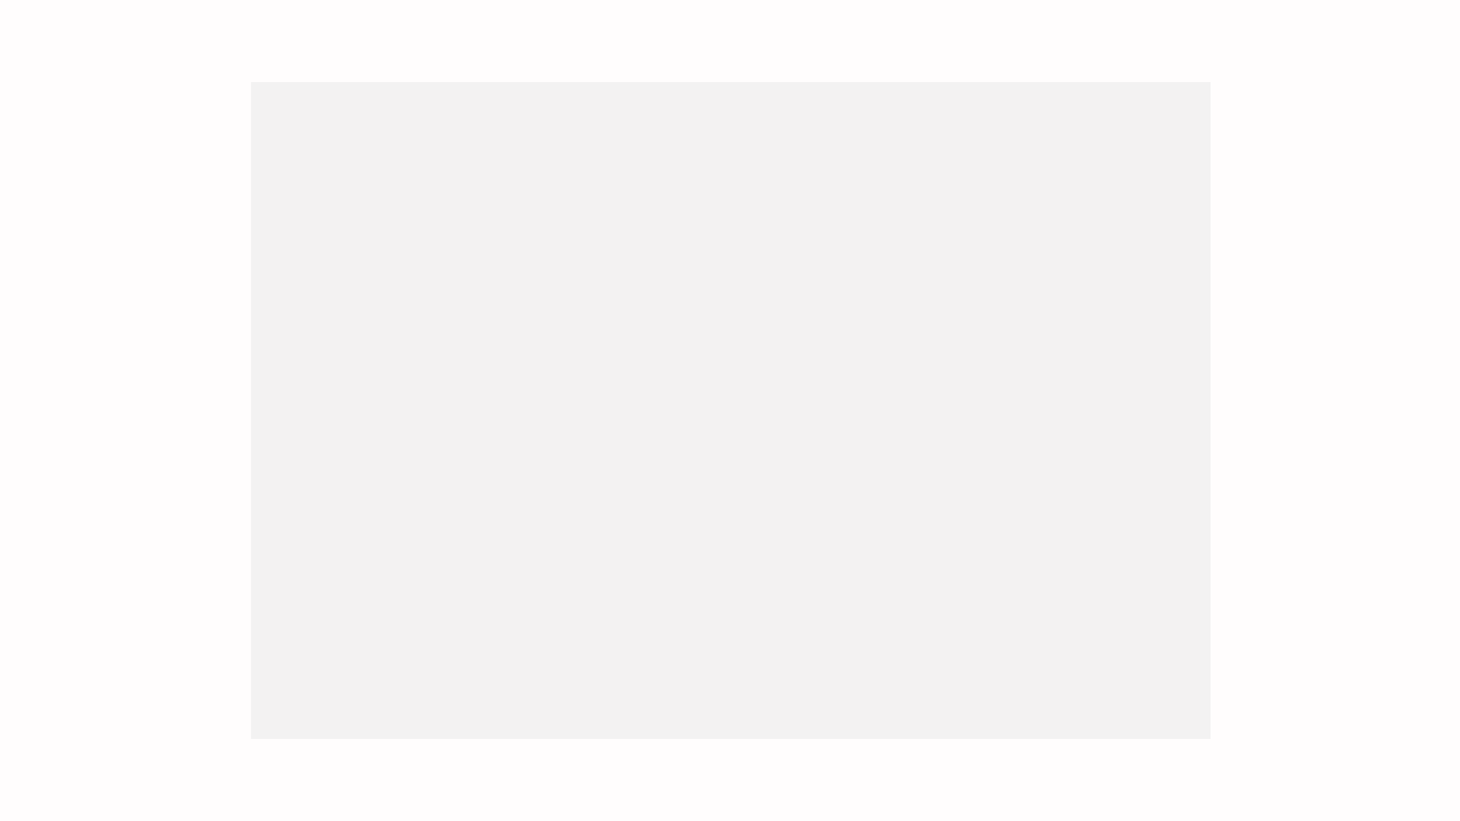

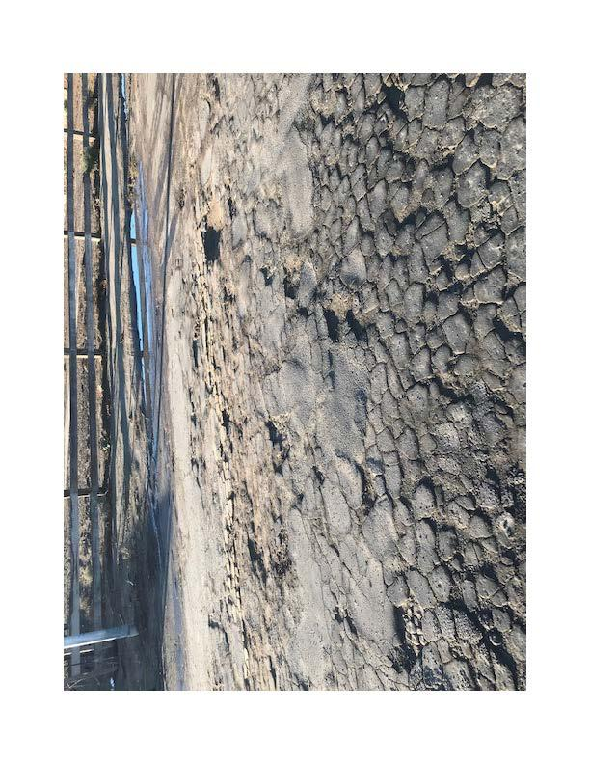
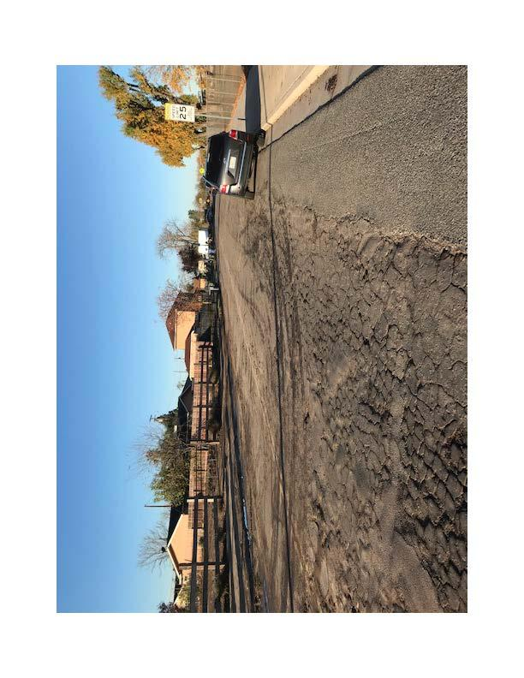
RESIDENT ENGAGEMENT
EXAMPLE
Notes:
Artie
2 min

Slide 19
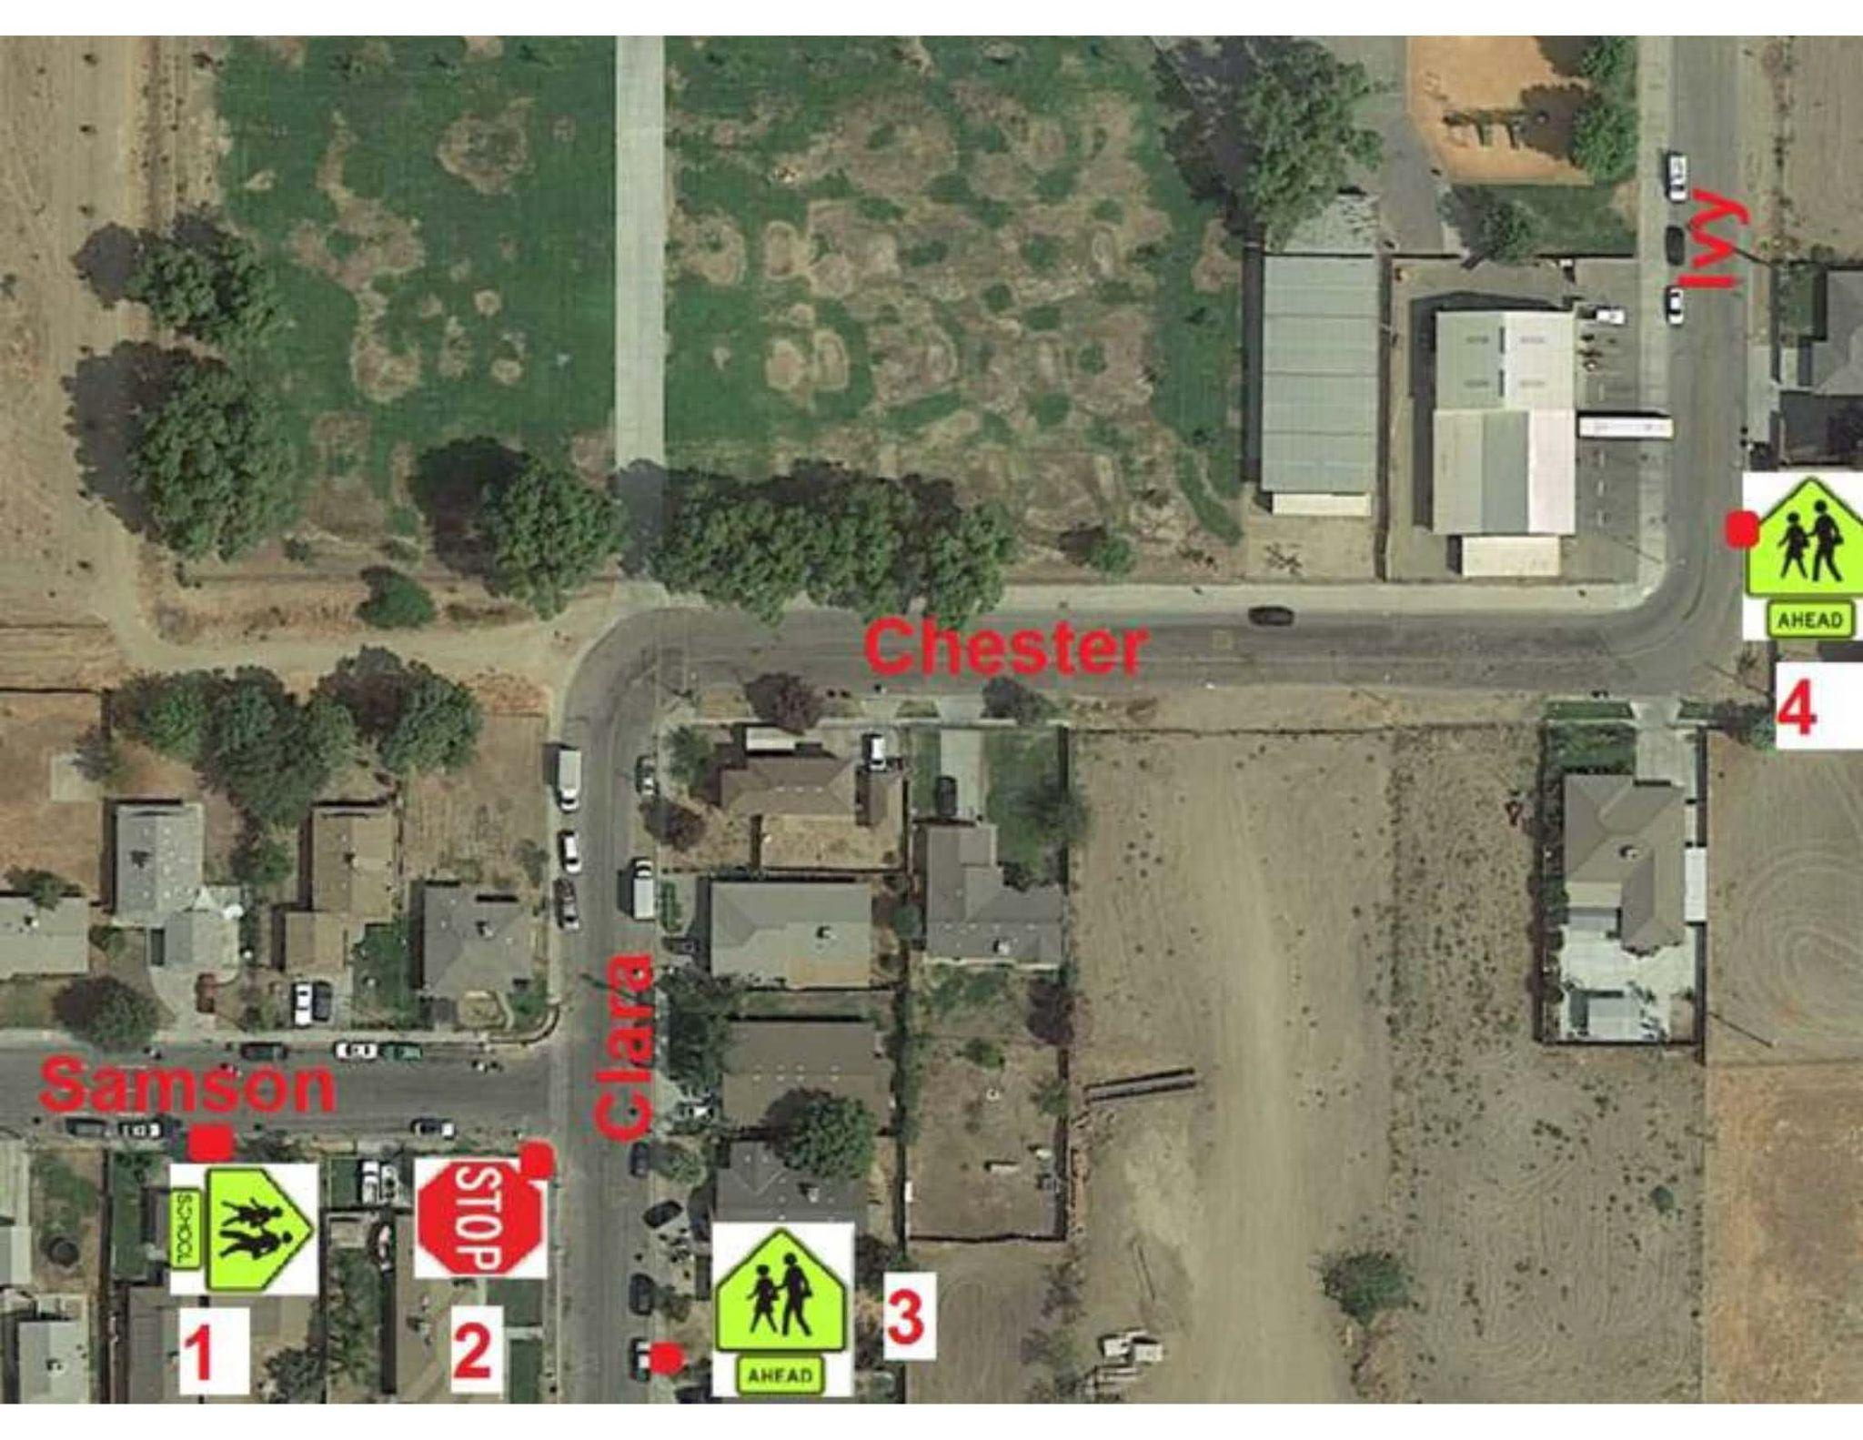
RESIDENT ENGAGEMENT
EXAMPLE
Site
Improvement
Plan
Notes:
Artie
2 min

Slide 20
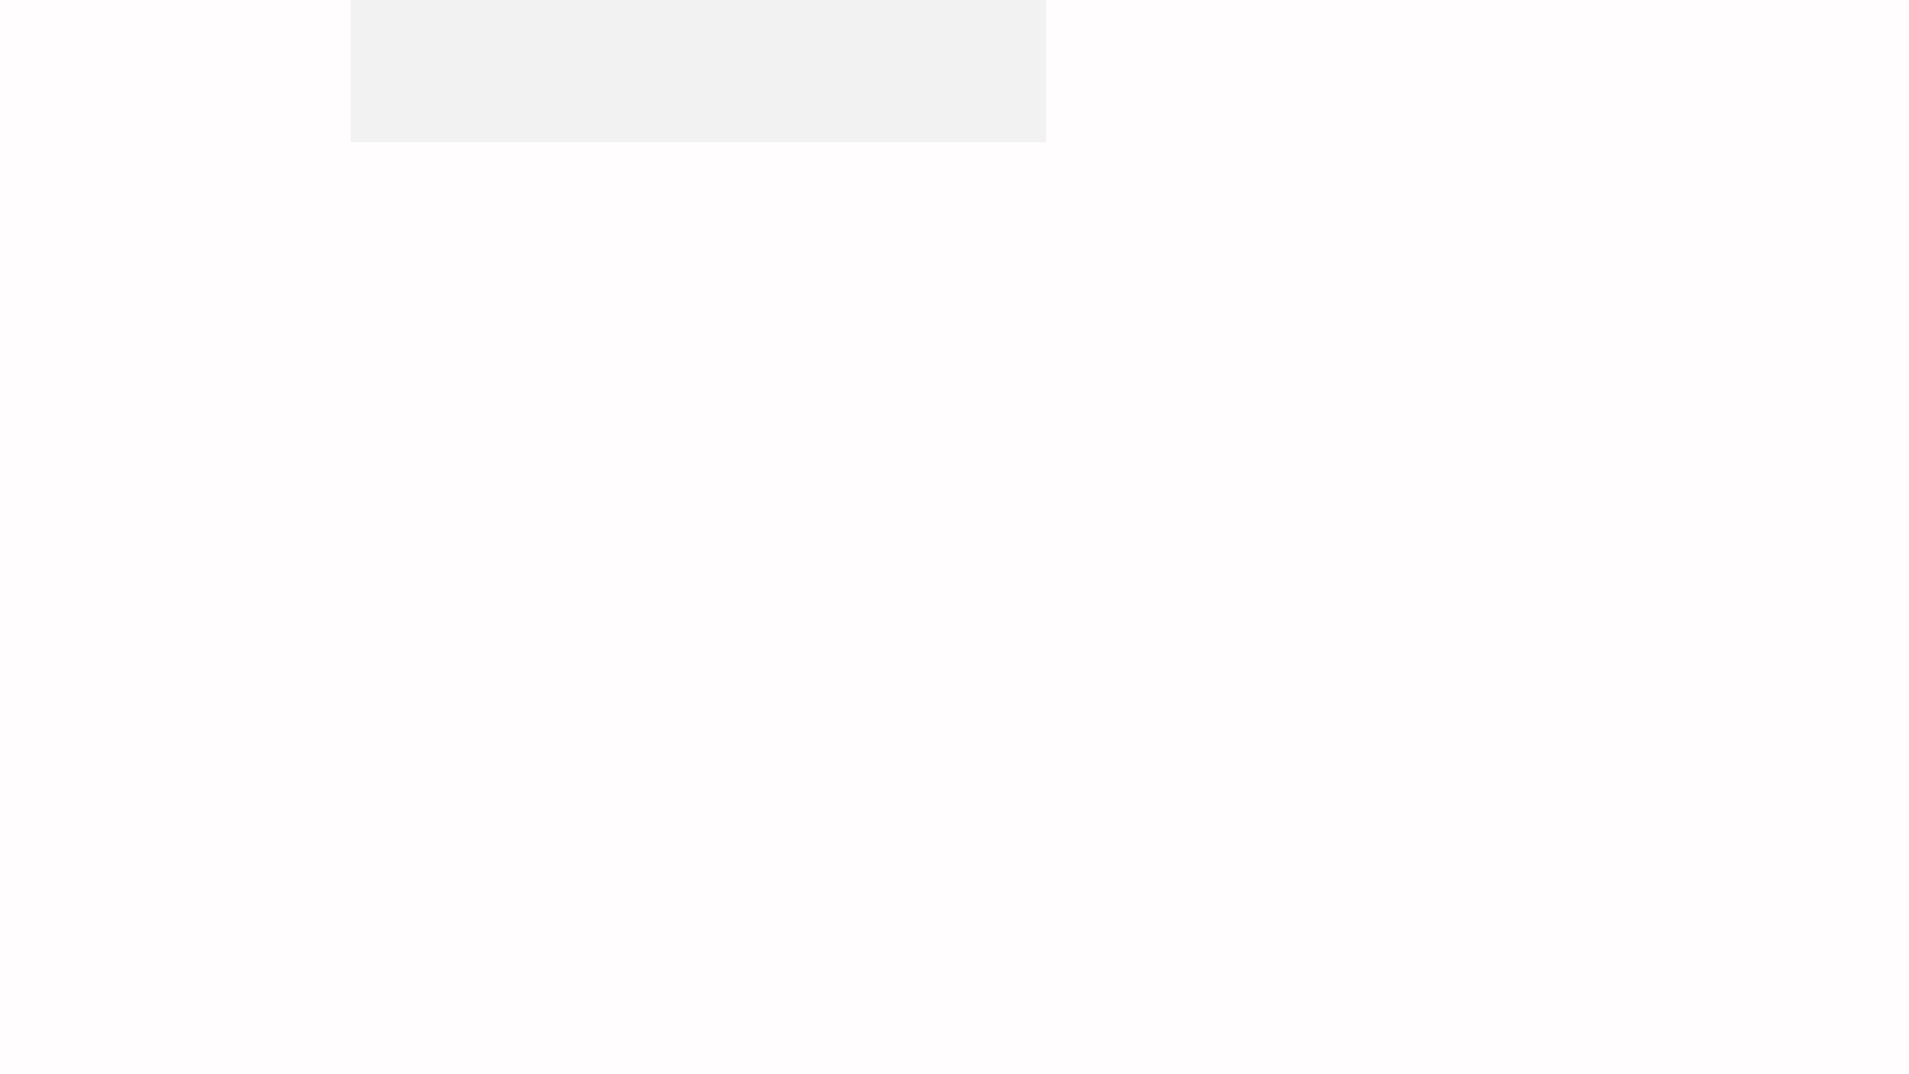
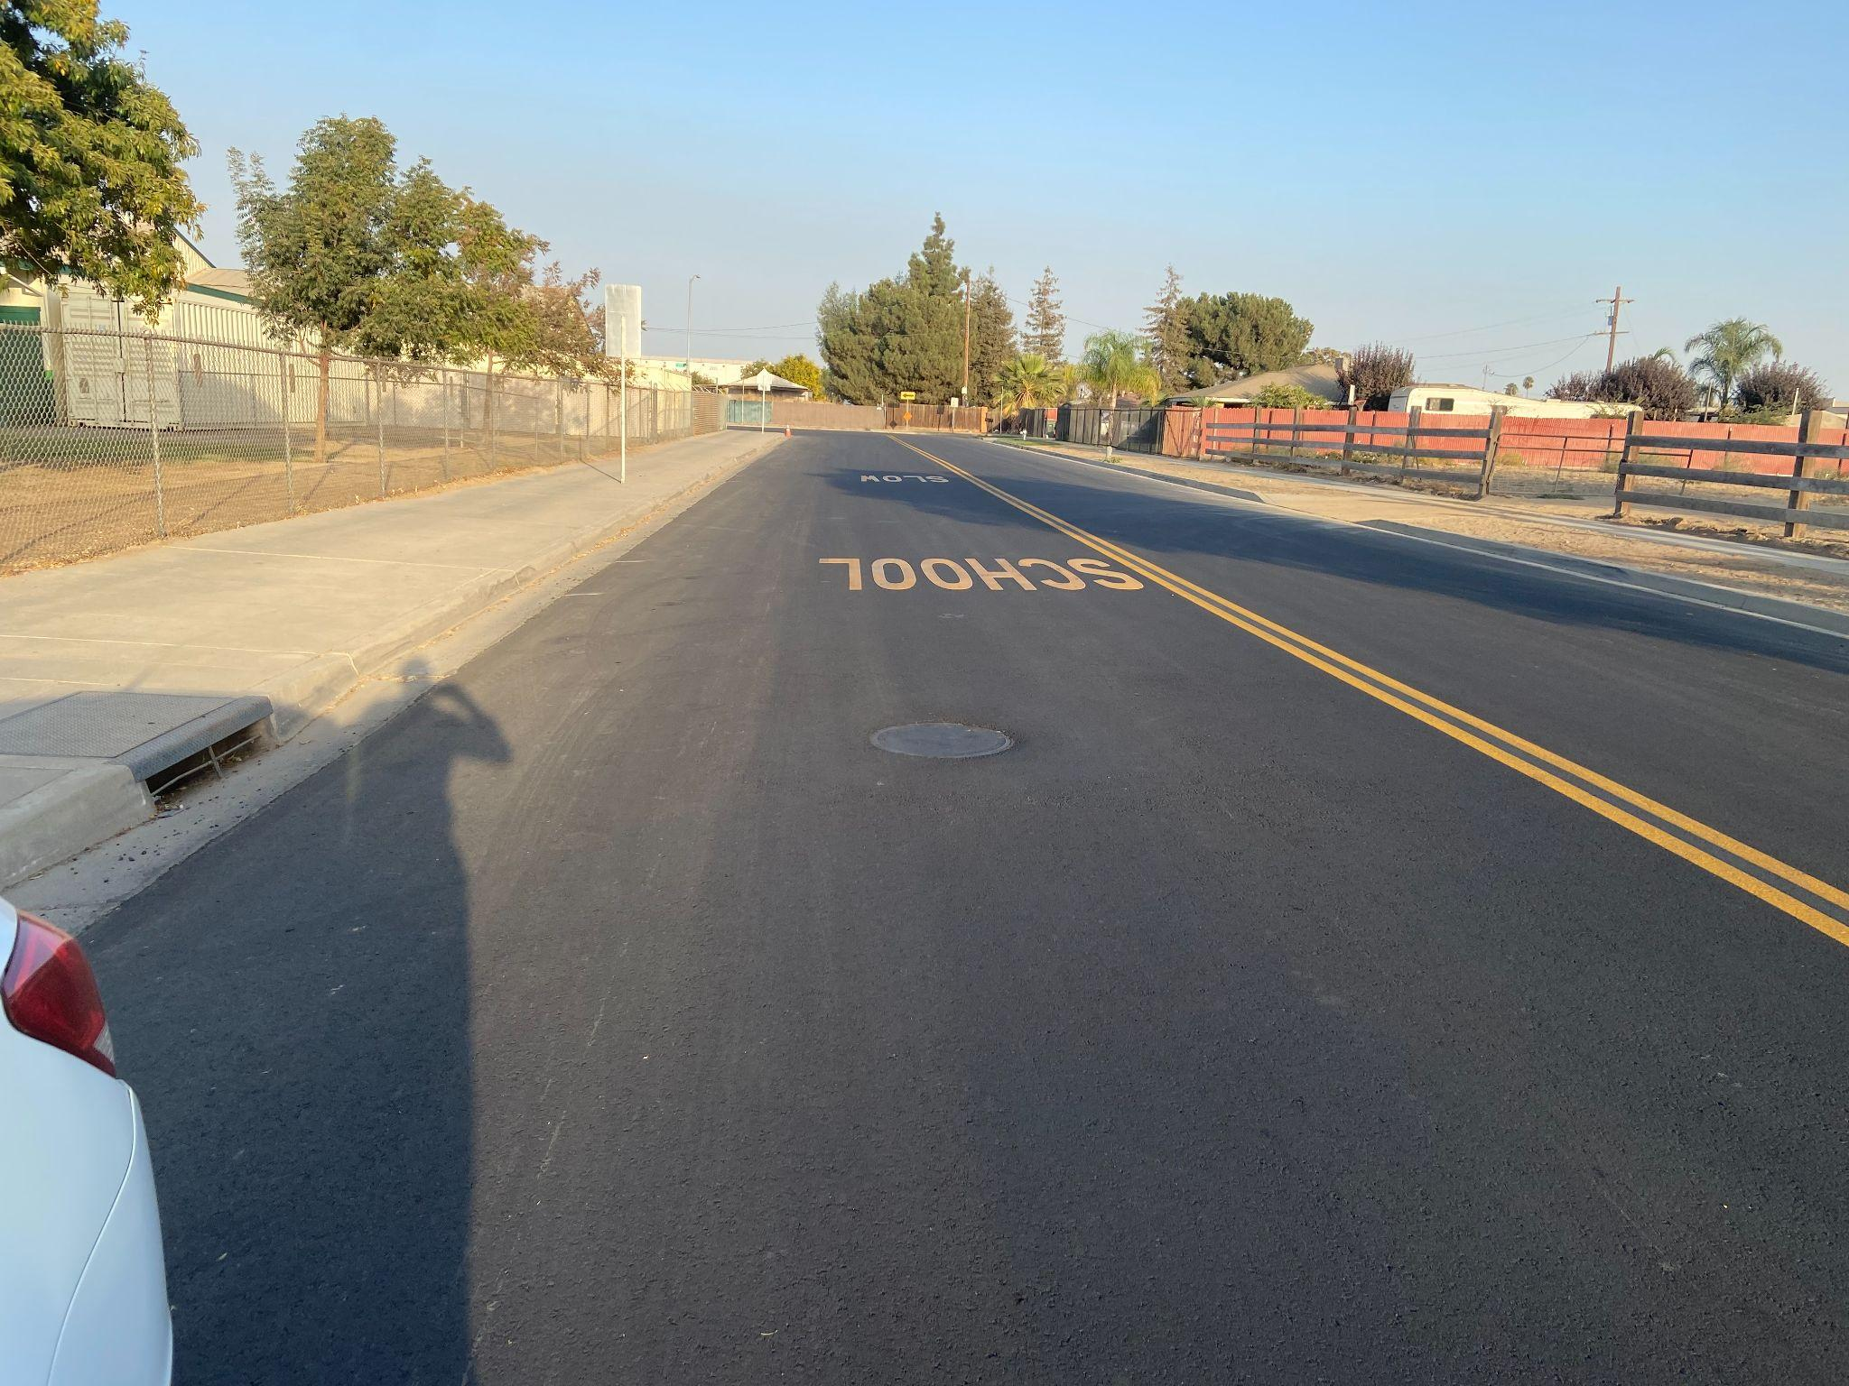
Newly
Paved
Road
RESIDENT ENGAGEMENT
EXAMPLE
Notes:
Artie
2 min

Slide 21
Organizations within the
Transportation Ecosystem
Council of Governments
Fresno County Transportation Authority
City & County of Fresno
Leadership Council on Justice & Accountability
Better Blackstone CDC
Cultiva La Salud
Notes:
Artie
10 min

Slide 22
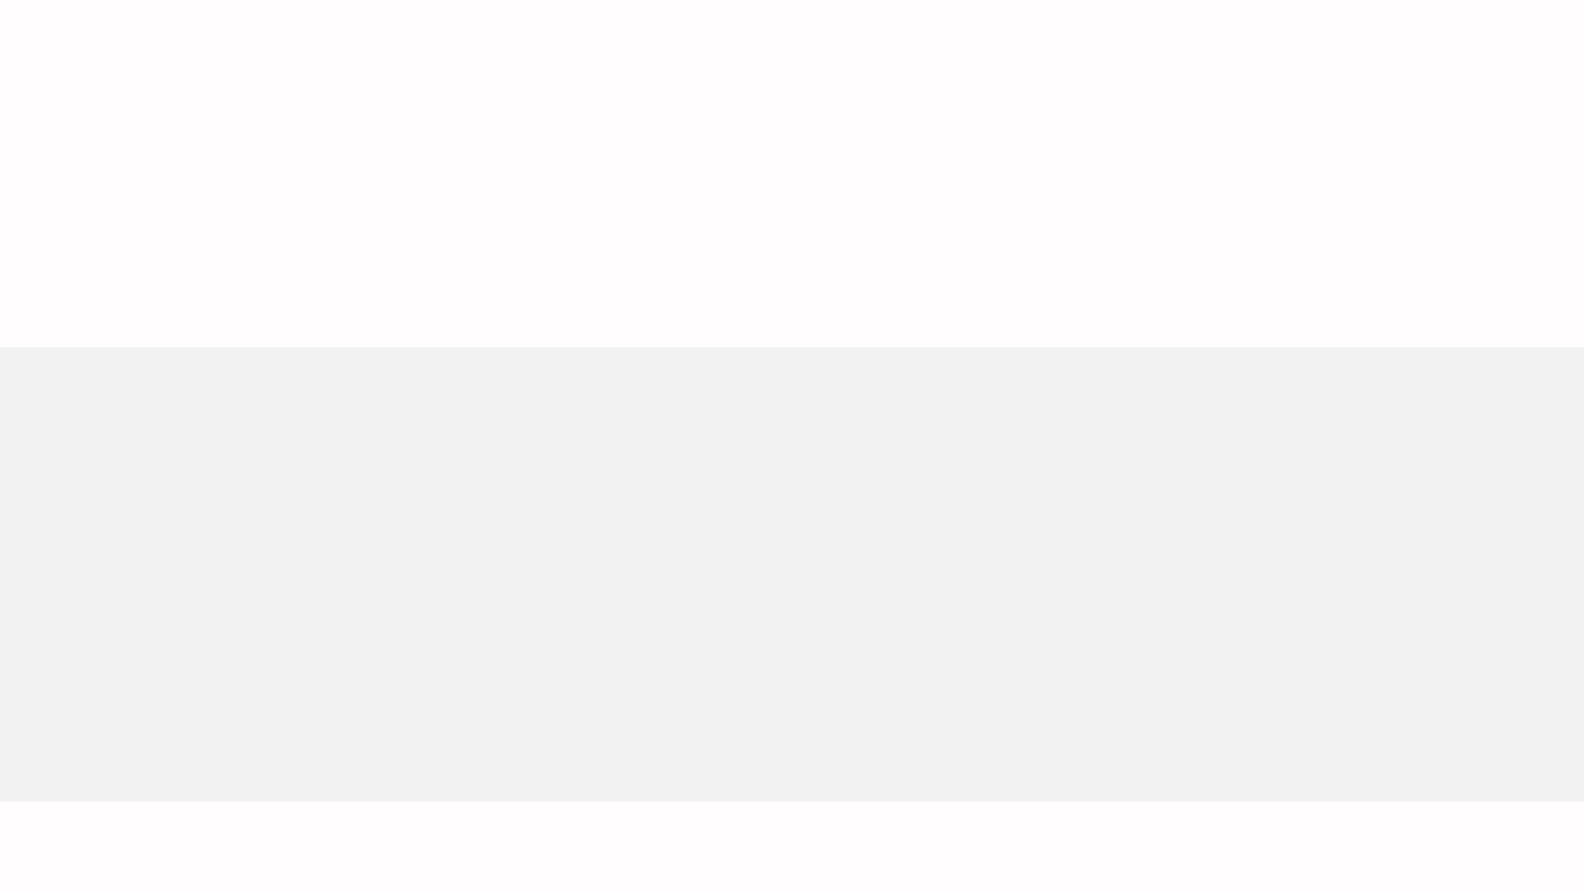
COLLECTING DATA
Healthy Fresno County:
http://www.healthyfresnocountydata.org/indicators/index/view?indicatorId=529&localeId=247
https://www.fresnocog.org/project/measure-c/
Census Reporter:
https://censusreporter.org/profiles/05000US06019-fresno-county-ca/
Fresno Council of Governments:
Notes:
10 mn

Slide 23
Extended Learning
How will this connect to our work?
Google Form Survey
Identify Current Situations
Notes:
Mike will talk about the survey and connection to the Core Team’s work.
5 min

Slide 24
Community Resources:

